Slide 1
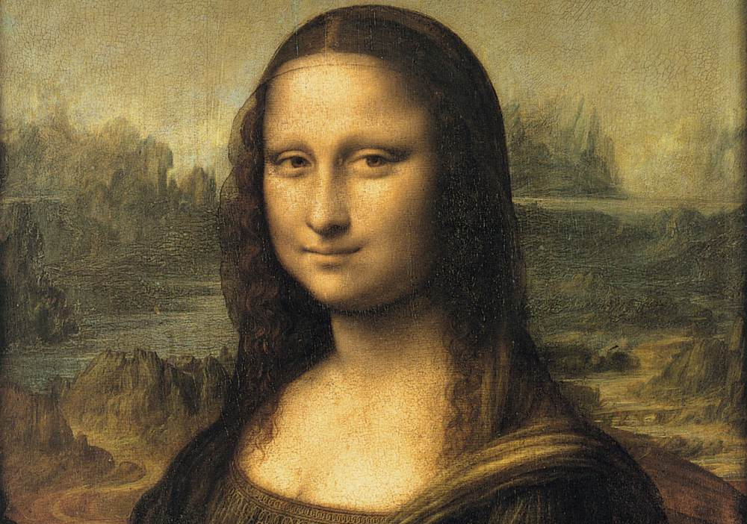

Slide 2
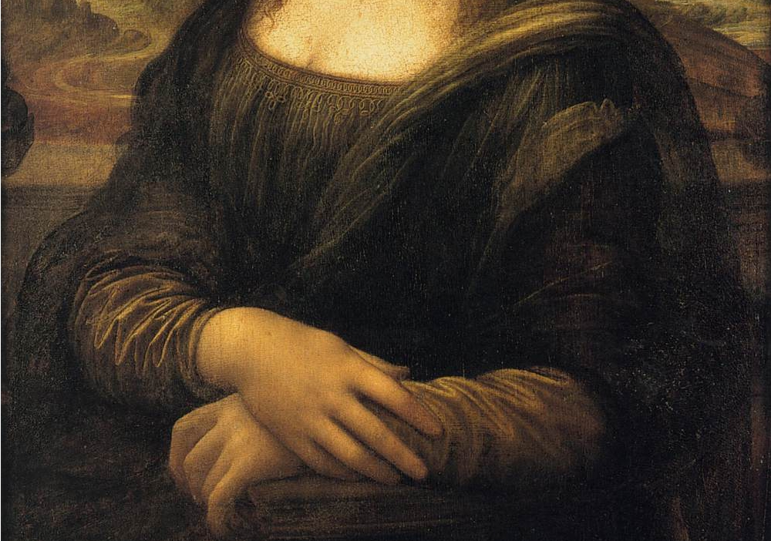

Slide 3
“Mona Lisa”
by Leonardo da Vinci (1452–1519)
This presentation uses the free image of Leonardo da Vinci's painting "Mona Lisa" found at the Web Gallery of Art via Wikipedia's list of public domain image resources.
A quote from Wikimedia concerning the original photograph;
“ The official position taken by the Wikimedia Foundation is that "faithful reproductions of two-dimensional public domain works of art are public domain, and that claims to the contrary represent an assault on the very concept of a public domain". For details, see Commons:When to use the PD-Art tag. This photographic reproduction is therefore also considered to be in the public domain.”
This presentation is the third in a series, and is released under the creative commons License:
You can copy, distribute, display, and modify this work — and derivative works based upon it — but only if you give credit the way I request, which is; for the text, none. For the modified graphics, none. For the original graphic, none.
R. Stacey – 9/12/2010
The software tools used to create this; Gimp 2.6.11 and of course Open Office 3.3.0

Slide 4
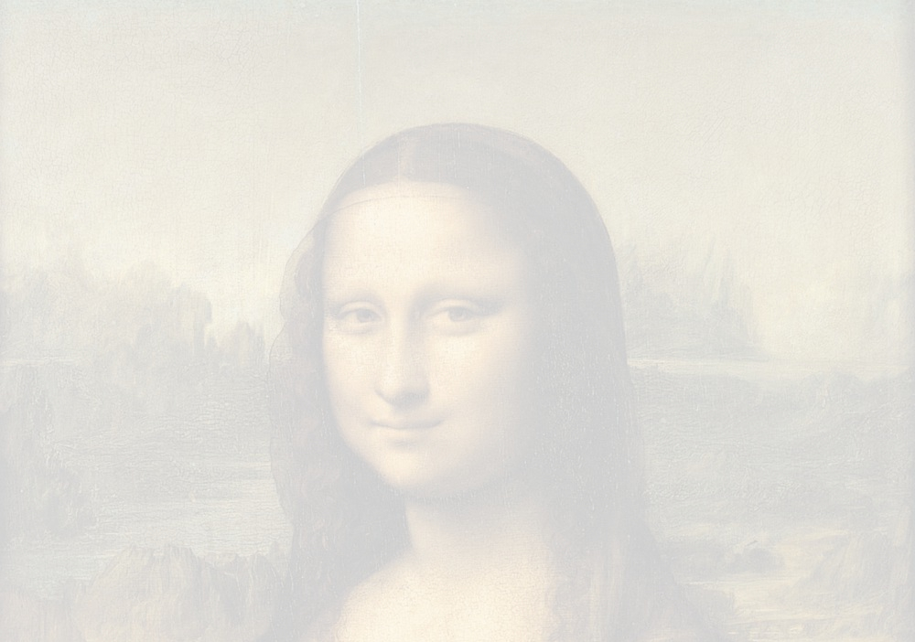

Slide 5
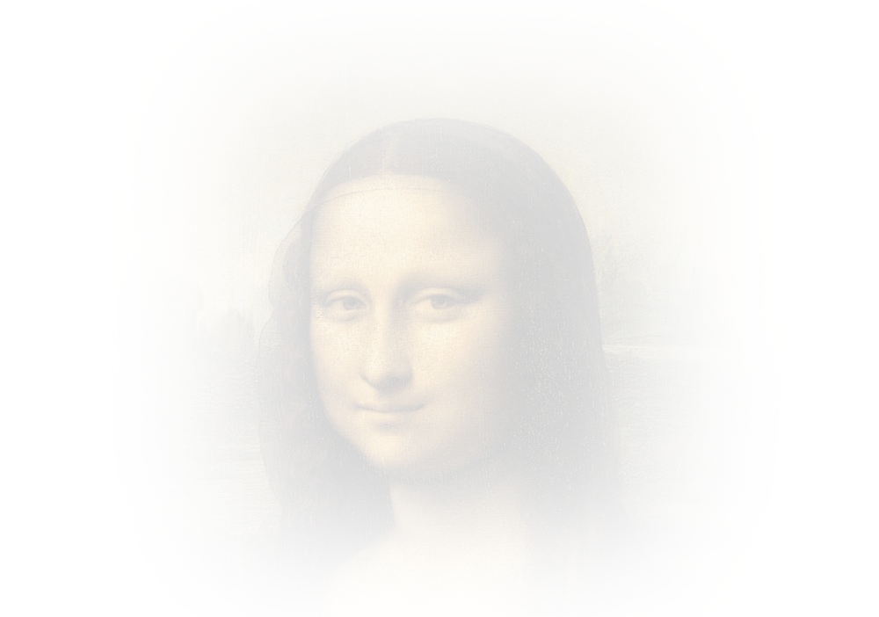

Slide 6


Slide 7

Mona Lisa

Slide 8


Slide 11
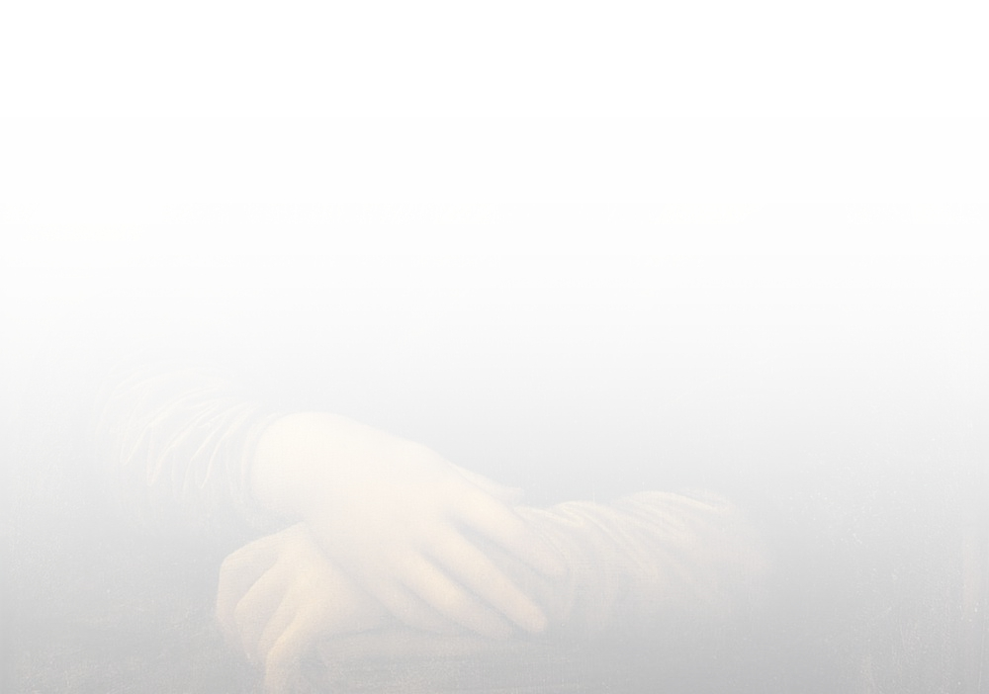

Slide 12


Slide 13


