Slide 1
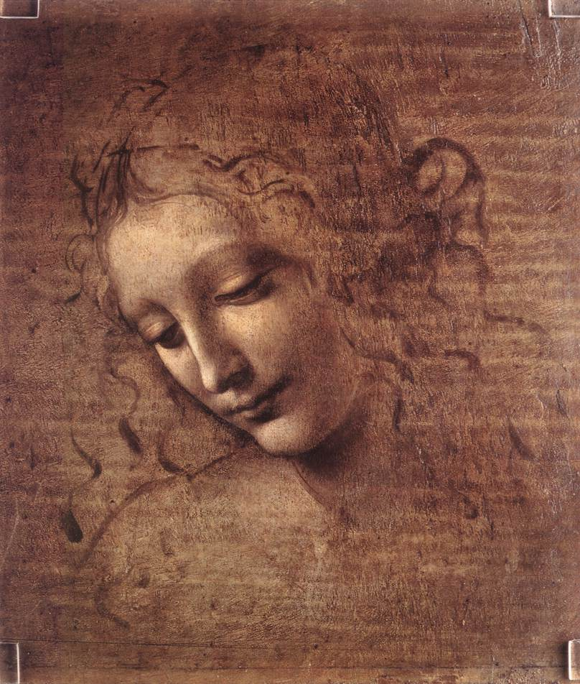

Slide 2
Leonardo da Vinci painting "La Scapigliata"
This presentation uses the free image of Leonardo da Vinci's painting "La Scapigliata" found at the Web Gallery of Art via Wikipedia's list of public domain image resources.
This presentation is released under the creative commons License:
You can copy, distribute, display, and modify this work — and derivative works based upon it — but only if you give credit the way I request, which is; for the text, none. For the modified graphics, none. For the original graphic, none.
A quote from Wikimedia concerning the original photograph;
“ The official position taken by the Wikimedia Foundation is that "faithful reproductions of two-dimensional public domain works of art are public domain, and that claims to the contrary represent an assault on the very concept of a public domain". For details, see Commons:When to use the PD-Art tag. This photographic reproduction is therefore also considered to be in the public domain.”
This is my second attempt at creating an Impress presentation template. I looked high an low for clear and concise instructions on how to create a template and couldn't find anything, so here are my instructions on creating this presentation, and consequently any similar template. I am by no means an expert, but I'm doing my best. Hopefully other will find this useful. Unfortunately the image is a little stretched and I didn't have the time to correct it, however I am still happy with how the presentation tuned out. You are welcome to add to, streamline, correct and use this template and these instructions.
R. Stacey – 4/12/2010
The software tools used were; Open Office 3.3.0 and Gimp 2.6.11.
Now, the instructions! Next slide!

Slide 3
Now, the Step by step instructions on how this was done:
Step one; Creating the images
  Obtain a public domain image of appropriate size, or use your own images. ( use a *.jpg). This image is 808x952.
    Open the image with Gimp
        From the menu bar choose Layer | Add Layer | Layer Fill Type “White” | OK – the graphic display goes white
                … Choose Layer | Stack | Reverse Order – your graphic re appears
        In the Layers toolbox (whatever it called)
          Click on “background” layer which should have a little icon of your graphic
          Move the opacity slider leftwards from 100% to 40% ~ 50% or whatever percentage suits your needs. (slider is in layers toolbox right above layer icons)
        From the menu bar choose File | save as
          Save the faded image with a new name, ending with “ .jpg “ [I will call it 2scapigl-f.jpg]
          When saving as “ .jpg “ a box will come up saying “your image should be exported before saving...”. Click on export., a box with a slider for “quality” and a few other options comes up. I always set quality at 100%, then click save.
        Close your original image.

Slide 4
Open your saved faded image [I will open 2scapigl-f.jpg]
  From the toolbox click on the select square icon [top row, far left]
      For a hard edge;
          Select everything you do not want
          From the menu bar choose Edit | Cut
                ... choose File | Save as
                Save the image with a new name, ending with “ .jpg “ [I will call this one tusami-fl.jpg]
      For a soft edge;
          Double the area you want to keep and select everything you do not want
          From the menu bar choose Edit | Cut
                … choose Select | Feather
                A feather Selection box comes up. Here you choose how much you want to feather. Bigger numbers mean slower / longer fade. I found it easier to feather by inches and choose between 1.5 ~ 2.0 “
                … choose Edit | fill with BG color
                … choose File | Save as
                Save the image with a new name, ending with “ .jpg “ [I will call this one 2scapigl-ff.jpg]
    Follow a similar procedure for a graphic strip on the left, bottom and so on.
    Slide eight was done in a similar manner, however the center part of the face was selected, then invert, then feather.

Slide 5
Step two; getting the graphics into Open Office
  Start Open Office
    click on “presentation”
    Create an empty presentation
    From the menu choose Format | Area, then Bitmaps | import
      Import all your new graphics
      You may get weird backgrounds on you blank presentation, but we will fix that.
    From the menu choose Format | Page, then the background tab | fill with bitmap.
      Find your graphic, highlight it, then;
        tick Original or Relative [ inthis case it didn't seem to matter]
        Select the center position
        Make sure Tile is un-checked.
        You can apply this background to all pages or just one
    Repeat as necessary
  That's it!

Slide 6
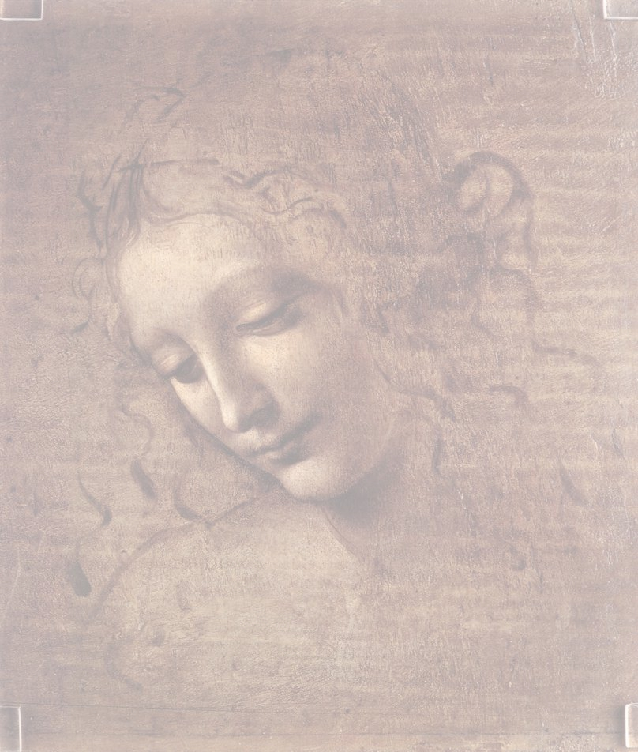

Slide 7
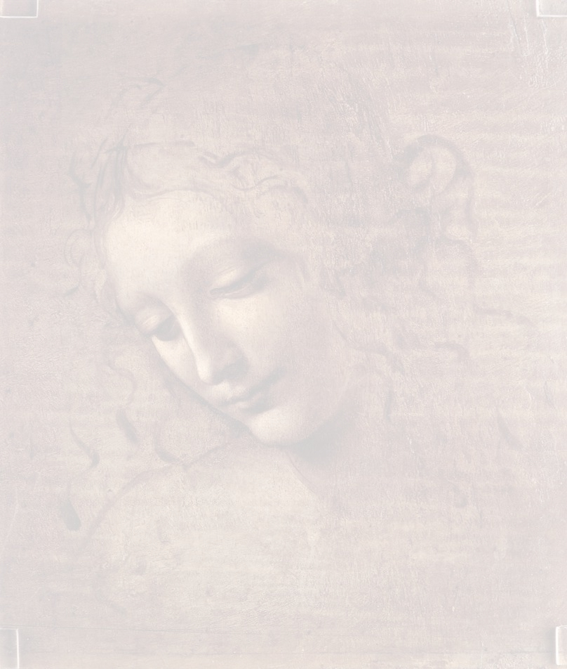

Slide 8


Slide 9
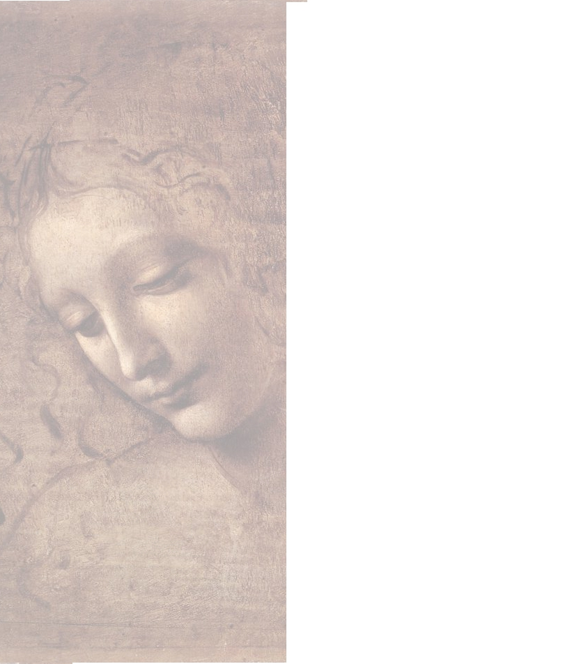

Slide 10
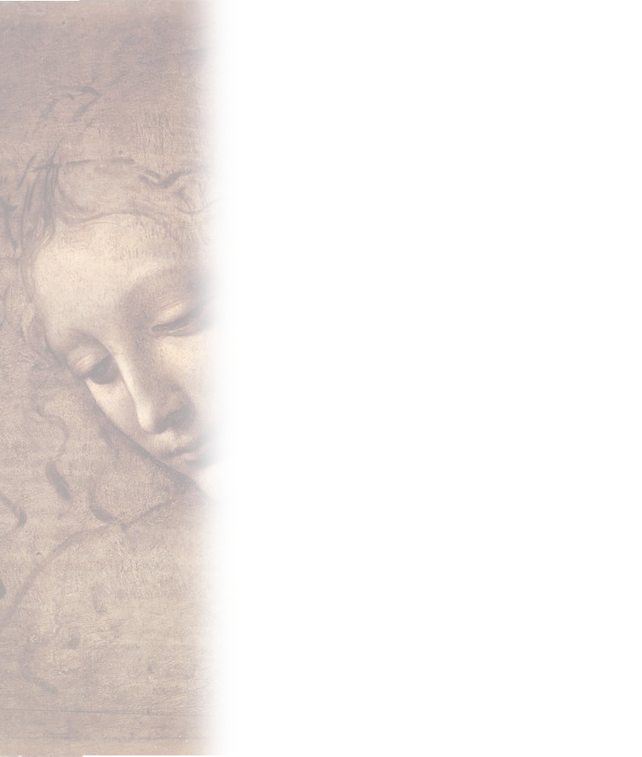

Slide 11
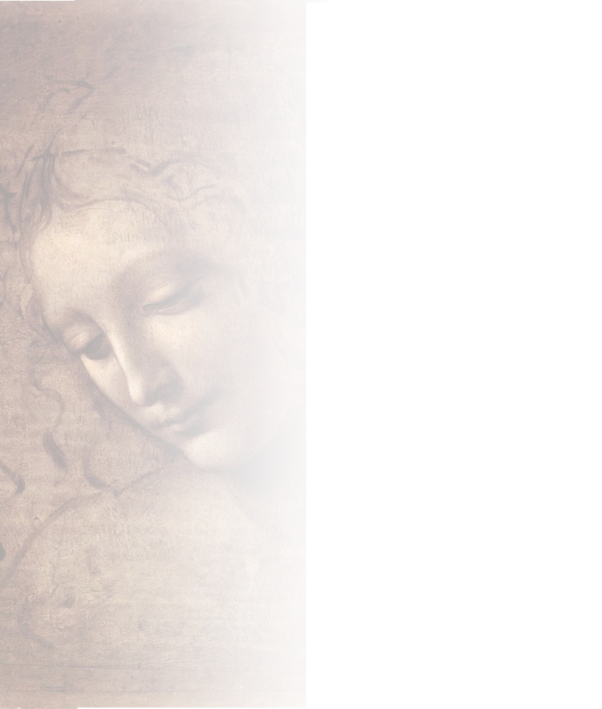

Slide 12
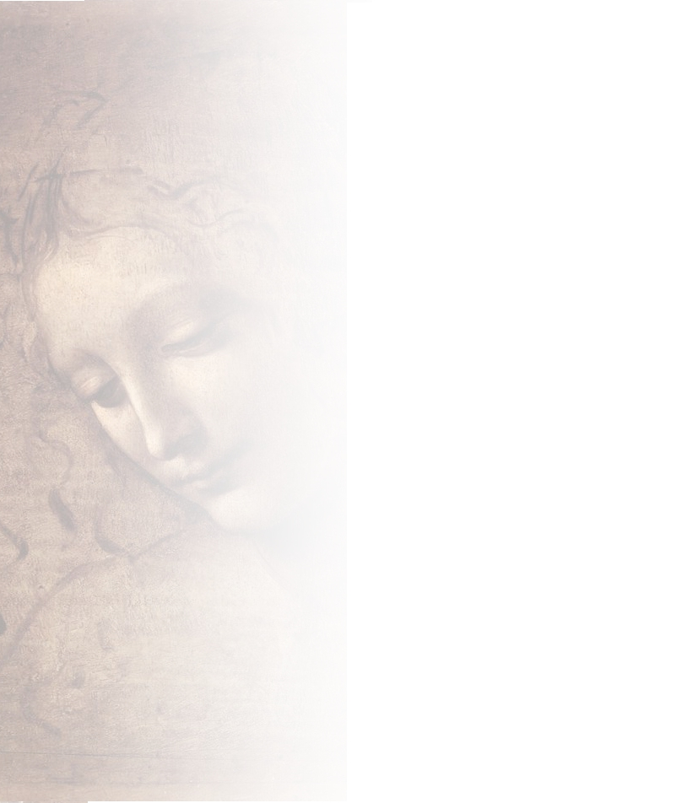

Slide 13
